Slide 1
Hobbies
Ge Ruipeng
Eric
Oct. 11th
Notes:
Good evening, everyone! I feel much honored to speak here, and I am very glad to share my hobbies with all of you tonight.

Slide 2
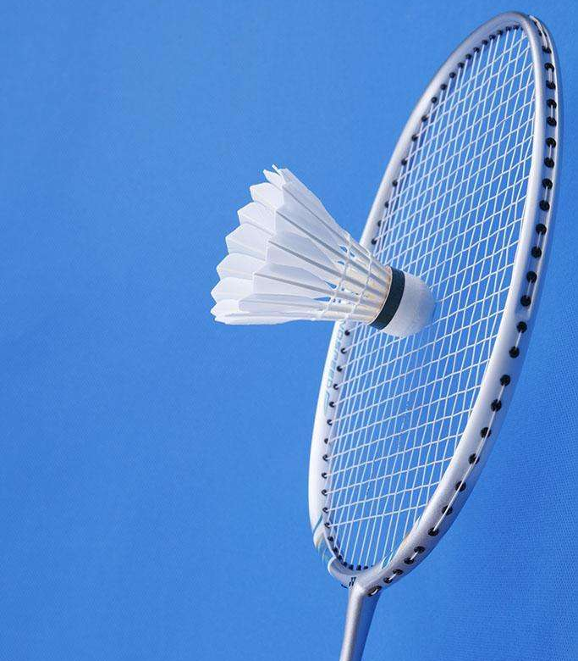
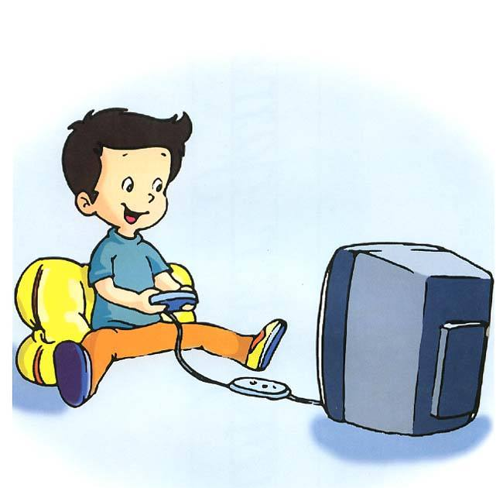

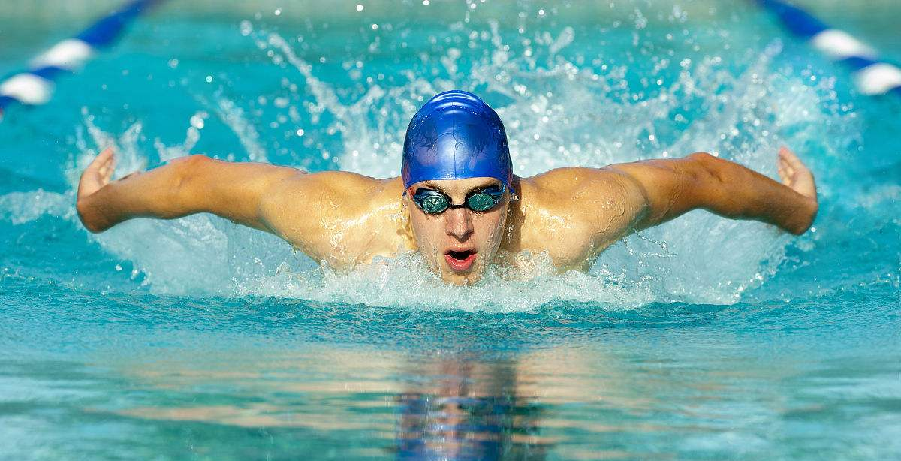
Hobbies
Leisure
time
Notes:
Actually, I always do a lot of things in my spare time. Well, like some of you, I love playing computer games, listening to music, swimming and doing other kinds of sports.

Slide 3
Travelling
Travelling experiences
Benefits of travelling
Notes:
But now, I’d like to talk about one of my favorite activities——travelling. In fact, I started travelling when I was very young. And I really enjoyed all of the beautiful sceneries. Of course, I have taken many pictures and I will share some of them with you.

Slide 4
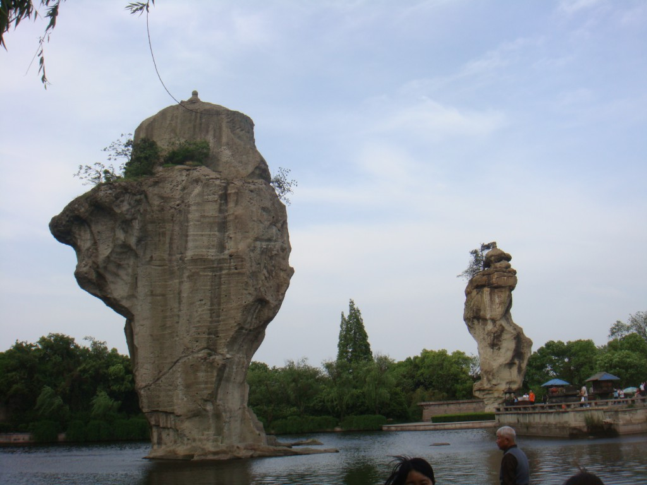
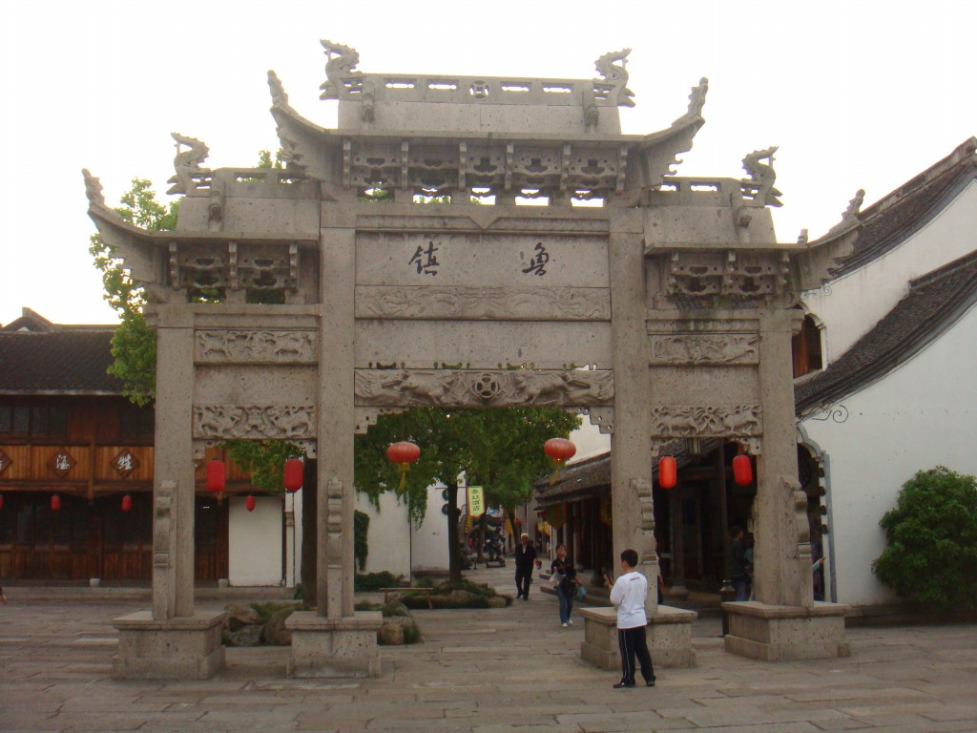
Travelling experiences
Notes:
These were taken when I was in primary school, and I went to Lu Xun’s hometown in Zhe Jiang Province.

Slide 5
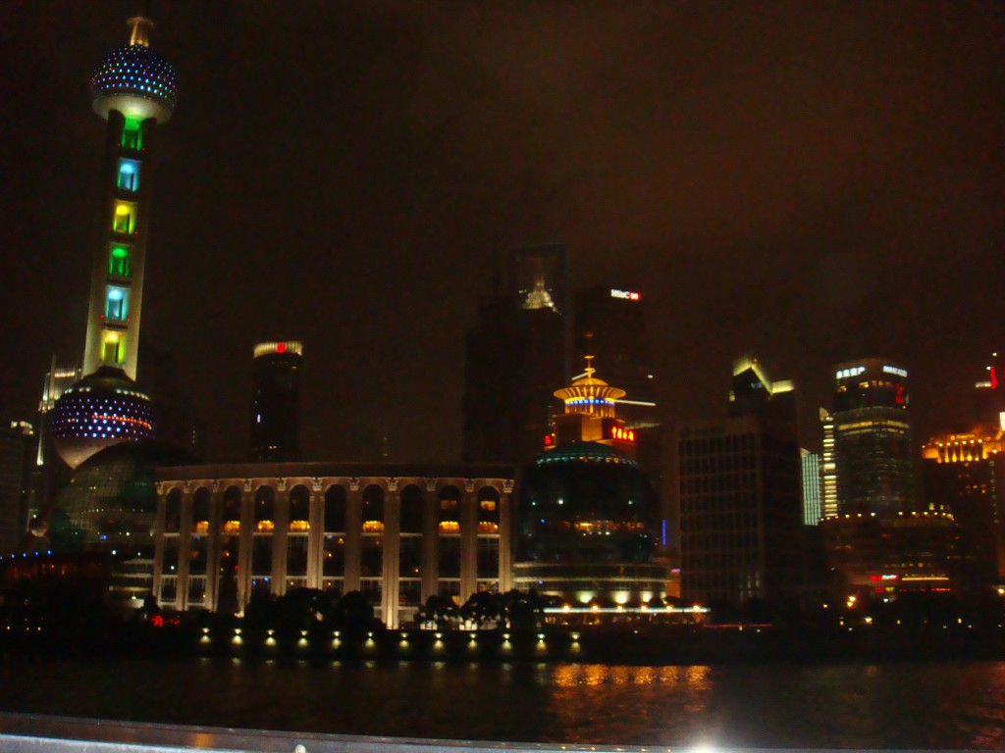
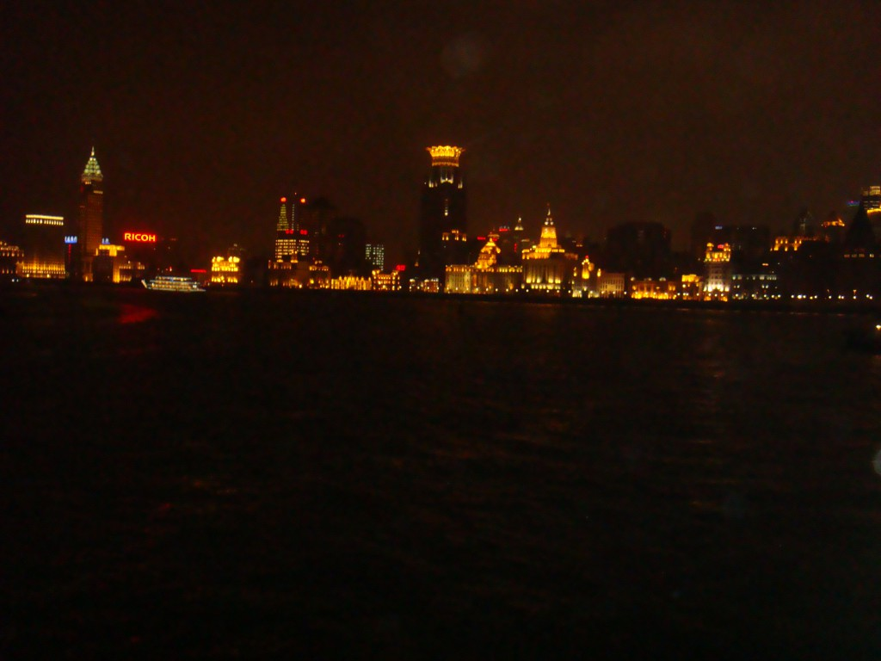
Travelling experiences
Notes:
And these are spectacular night sceneries in Shanghai.

Slide 6
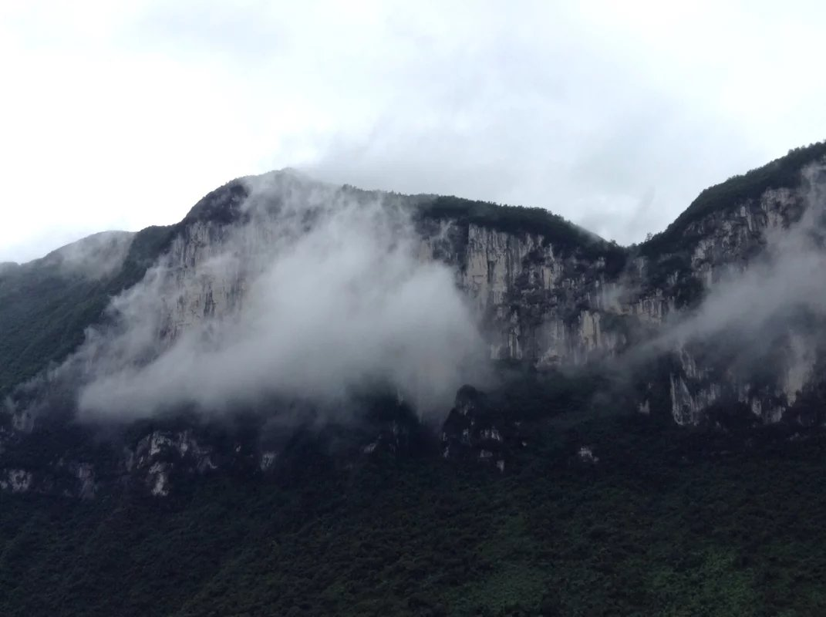
Travelling experiences
Notes:
This was taken when I was in middle school. I went to Hubei Province to enjoy these beautiful mountain sceneries.

Slide 7
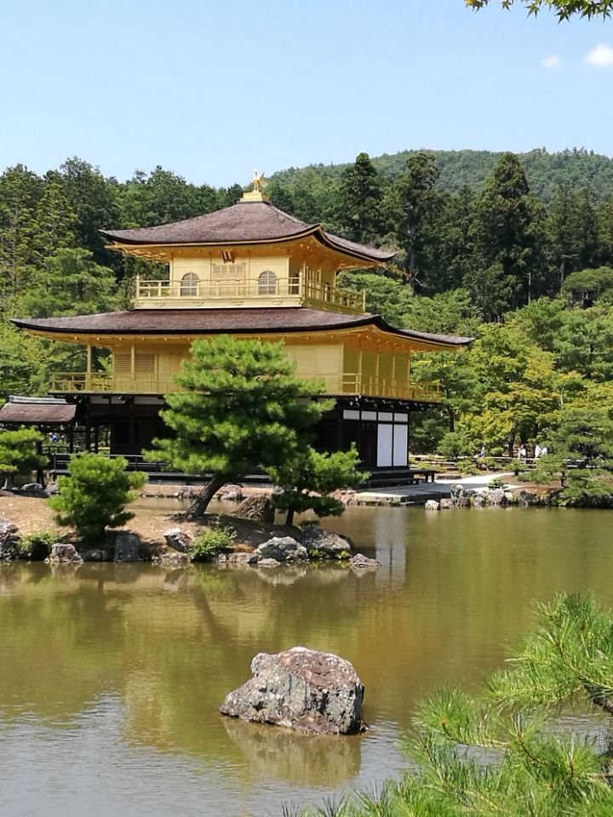
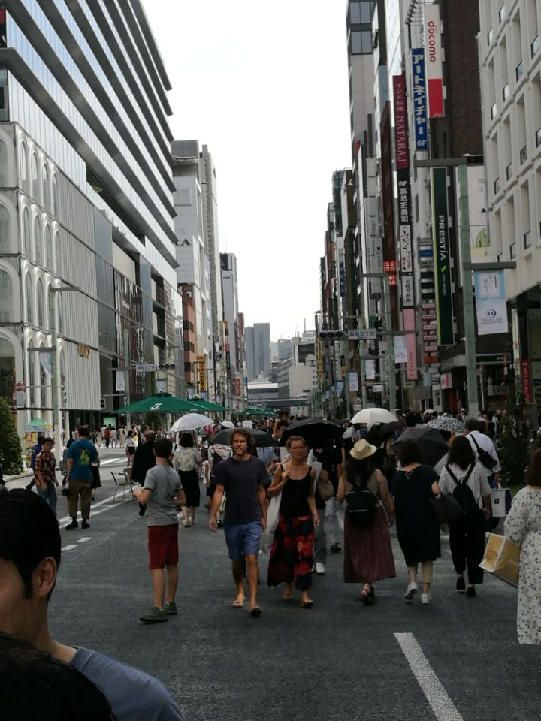
Travelling experiences
Notes:
And when I graduated from high school, I flew abroad to Japan for a short stay, and I enjoyed both sights of historical sites and modern Metropolitan area as well as the tasty Japanese style’s food.

Slide 8
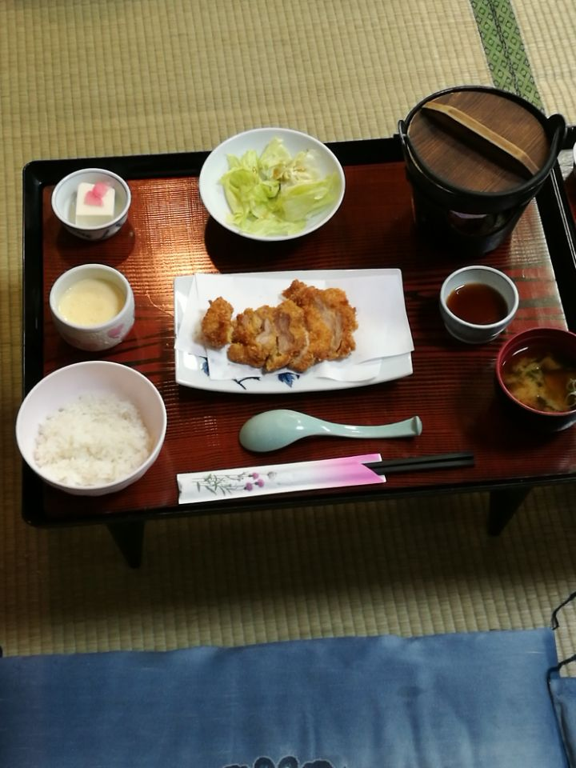
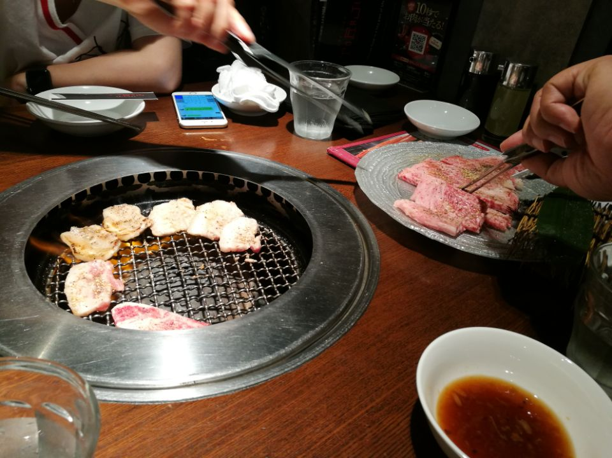
Travelling experiences

Slide 9
Benefits of travelling
Get relaxed mentally
Enrich knowledge
Travelling
A kind of exercise
Broaden horizon
Notes:
Recently, I have travelled to so many places and I decide to keep travelling to more places because I can benefit a lot through travelling. Not only can I relax myself and lift up my spirits when exposed to attractive natural sceneries, but also I will broaden my horizon and enrich my knowledge especially going to visit some historical sites or culture heritage. That means you can both find your happiness and learn a lot of things that cannot be learned from books.

Slide 10
Benefits of travelling
‘It is better to travel ten thousand miles than to read ten thousand books.’
Notes:
Just like an ancient Chinese saying goes, ‘It is better to travel ten thousand miles than to read ten thousand books.’ Our world is full of treasures. And by exploring them, we can always get surprised by the miracles the world presented to us.
Thank you very much!

